Slide 1
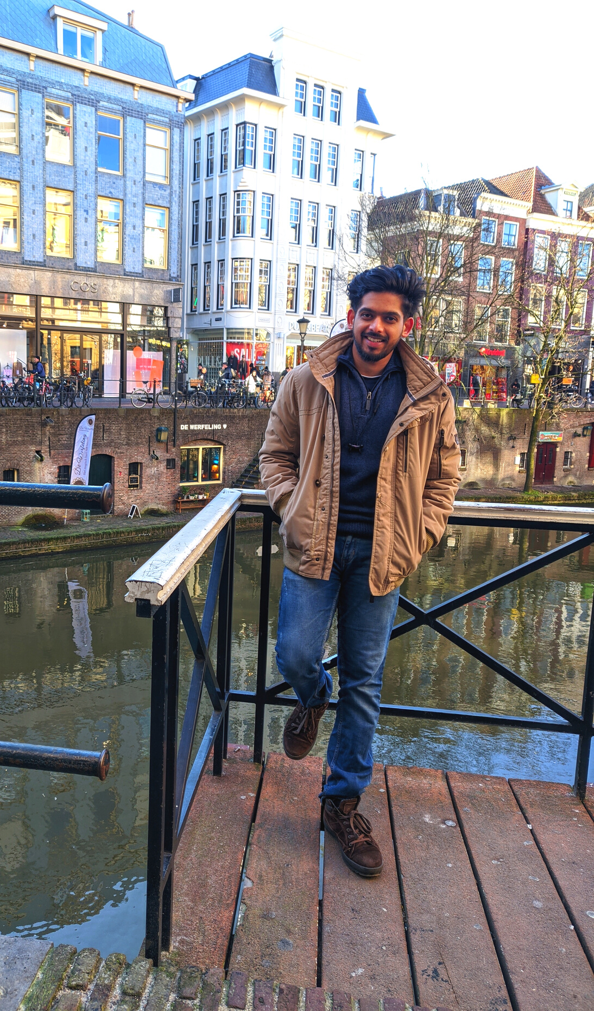

HI, EVERYONE! MY NAME IS
Jishnu Jayaraj
Thank you for having me.

Slide 2
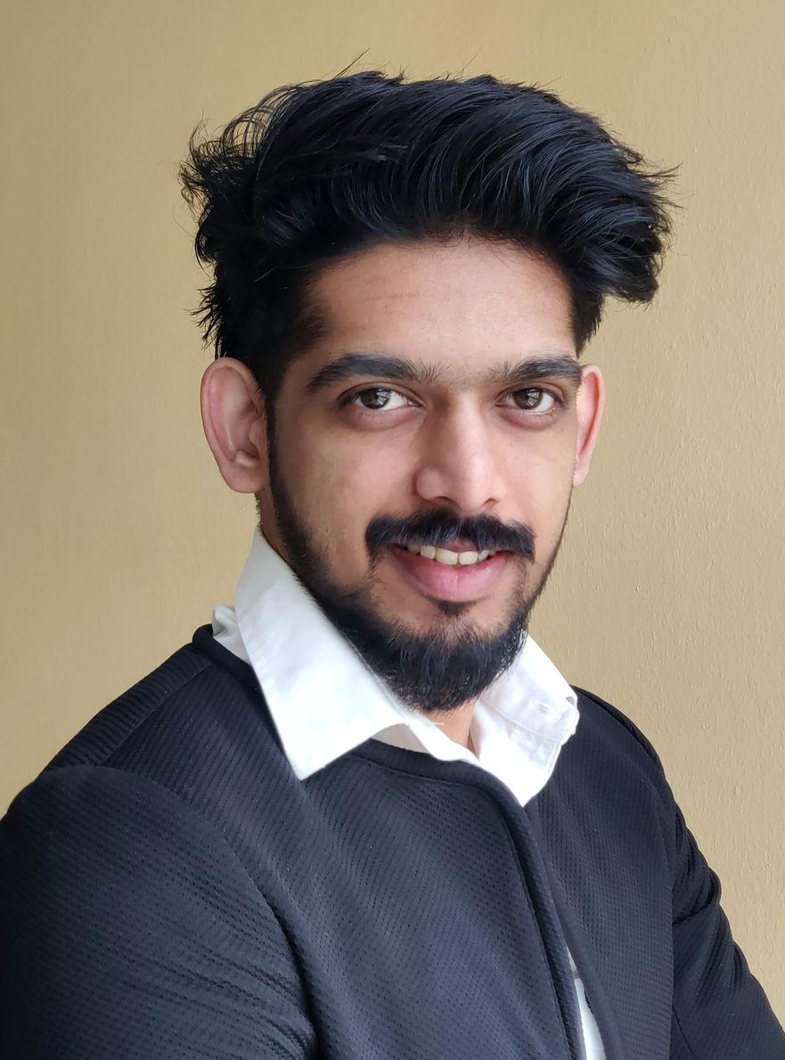
Hi again! Call me Jishnu and I'm a recent Computational Engineering graduate!
I'm a people person and I like helping others. I'm excited to dip my toes in the industry.

Slide 3

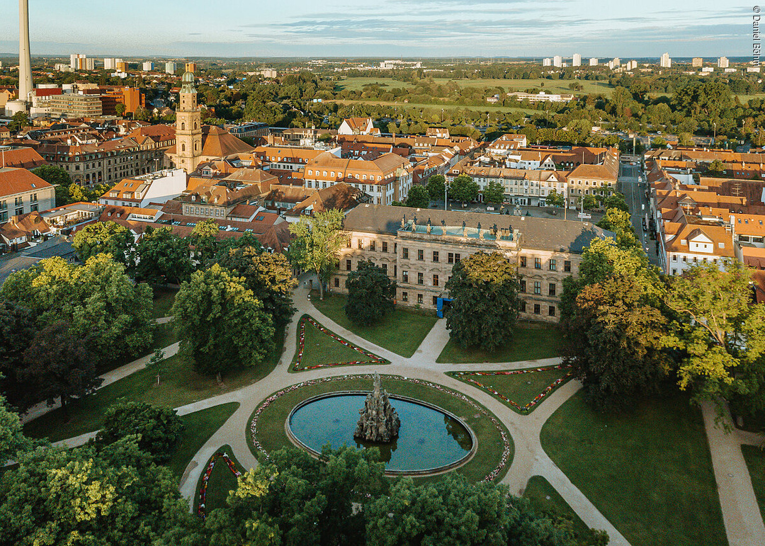
Where
I am based
I was born and bought up in beautiful backwaters in Kerala.
I moved to Germany to persue my masters
I currently live in Erlangen.

Slide 4

Educational Background
A quick history of the studies I've undertaken
2012
2012 - 2016
2018 - 2021
Highschool
Bachelors: Mechanical Engineering
Masters: Computational Engineering
science
computer programming
GPA: 9.5/10
Simulation
Computational mathematics
Thermodynamics
GPA: 7.9 / 10
Fluid Simulation
Machine Learning
High Performance computing
GPA: 2.0 / 4

Slide 5

Where I've Worked
A quick history of companies I've been with
2016
2018
11/2018 - 11/2019
04/2020 - 02/2021
Global Aerosports: Intern
Academic Assistant
Siemens Healthineers
Rokin
RC Aeromodeling
Robotics
Documentation
Matlab
App designing
Virtualization
Scripting in Linux
Deep Learning
AWS cloud system
NLP
Data analytics
Cloud platform: GCP

Slide 6
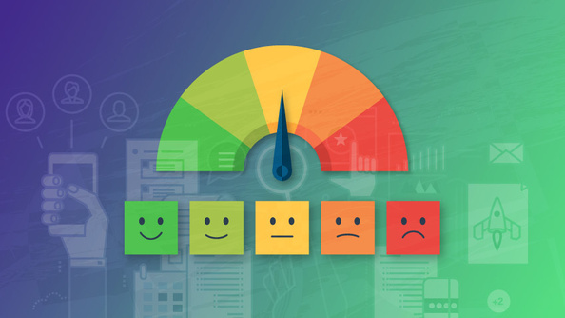
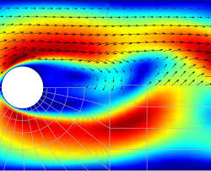
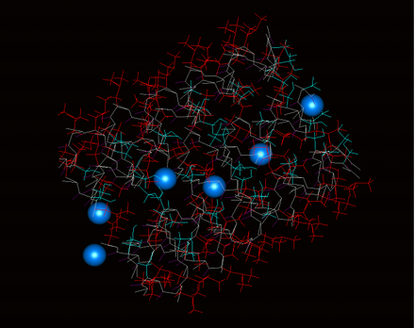
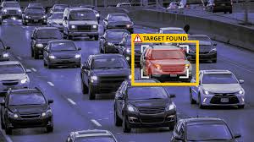

Snapshots of my
Side Projects
I dabble projects from different MOOC courses and Blogs.
Sentiment classification
Fluid simulation
GPU programming
Object detection
More projects at my Webpage or Github
Trend detection

Slide 7


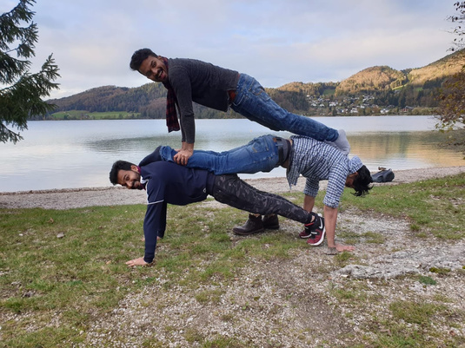
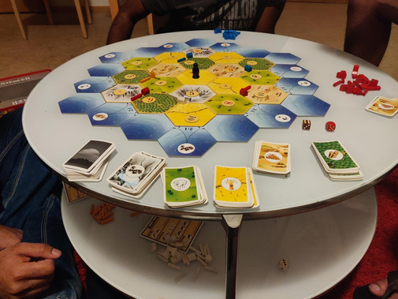
What I Do During My Free Time
Things that keep me occupied usually on weekends
GAMING
HIKING
BOARD GAME
I love playing around with my friends. Its a perfect tool for de-stress
Love to climb heights. This helps to keep the body fit and travel at same time.
Since the pandemic me and my friends bought some board games and since then the weekends have been always a game night.

Slide 8
MY STRENGTHS
Young, energetic and motivated engineer. Let me know how I can assist you with anything related to machine learning and NLP.
What You Can Come to Me For
CURRENTLY LEARNING
Currently learning more about Big data and ML production systems. These are the topics that directly leads to growth of ML. Also tech changes continuously and its important to stay up to date
Please don't hesitate to reach out!
CAT PHOTOS
If you want them, I will send or show you cat photos -
no questions asked. Sometimes, I may send or show them even if nobody asked and for that I apologize in advance.

Slide 9
EXCITING PROJECTS
Active roll in projects with flat heriarchies
COMMUNICATIONS AND SUPPORT
What I expect from Vencortex
Peoples person- Integration with team like events and knowledge transfer
LEARN AND GROW
Opportunities for training programs. Stay on par with latest tech, new challenges over time. MLops in future?
MONEY
Reasonable income so that I can get more cats and send more cat videos.

Slide 10
I'M A CHEF TOO.
I'm not just a passionate engineer, I'm also an enthusiastic cook!
Fun Facts About Me
I WORK BEST WITH BACKGROUND MUSIC
I believe good music is a strong driving force behind every stellar performance
IM A TECH GURU
I love electronic gadgets. Loves to talk about tech forever

Slide 11

Thank You!
Looking forward to meeting everyone!
If data is the new oil, then NLP gives everyone a drill
FROM THE MILLERS

